Slide 1


VLF E Series VLF and Tan Delta Hook Up and control with E-Link
ISO 9001 2008
The World’s Source for High Voltage Test Equipment
MADE IN THE USA
High Voltage, Inc. • hvinc.com • p. 518.329.3275 • f. 518.329.3271 • 31 County Route 7A • Copake, NY 12516 USA

Slide 2
Disclaimer
This guide for the High Voltage, Inc. E Series of VLF hipot and Tan Delta bridge hook up is meant to be for reference only. The instructions are intended to be clear and simple, but the operator must be trained and qualified according to the customer’s established procedures for the use of this type of equipment.
ISO 9001 2008
The World’s Source for High Voltage Test Equipment
MADE IN THE USA
High Voltage, Inc. • hvinc.com • p. 518.329.3275 • f. 518.329.3271 • 31 County Route 7A • Copake, NY 12516 USA

Slide 3
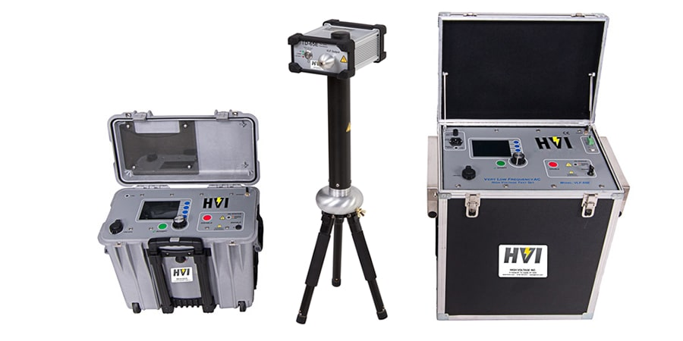
VLF and Tan Delta Hook Up
ISO 9001 2008
The World’s Source for High Voltage Test Equipment
MADE IN THE USA
High Voltage, Inc. • hvinc.com • p. 518.329.3275 • f. 518.329.3271 • 31 County Route 7A • Copake, NY 12516 USA

Slide 4
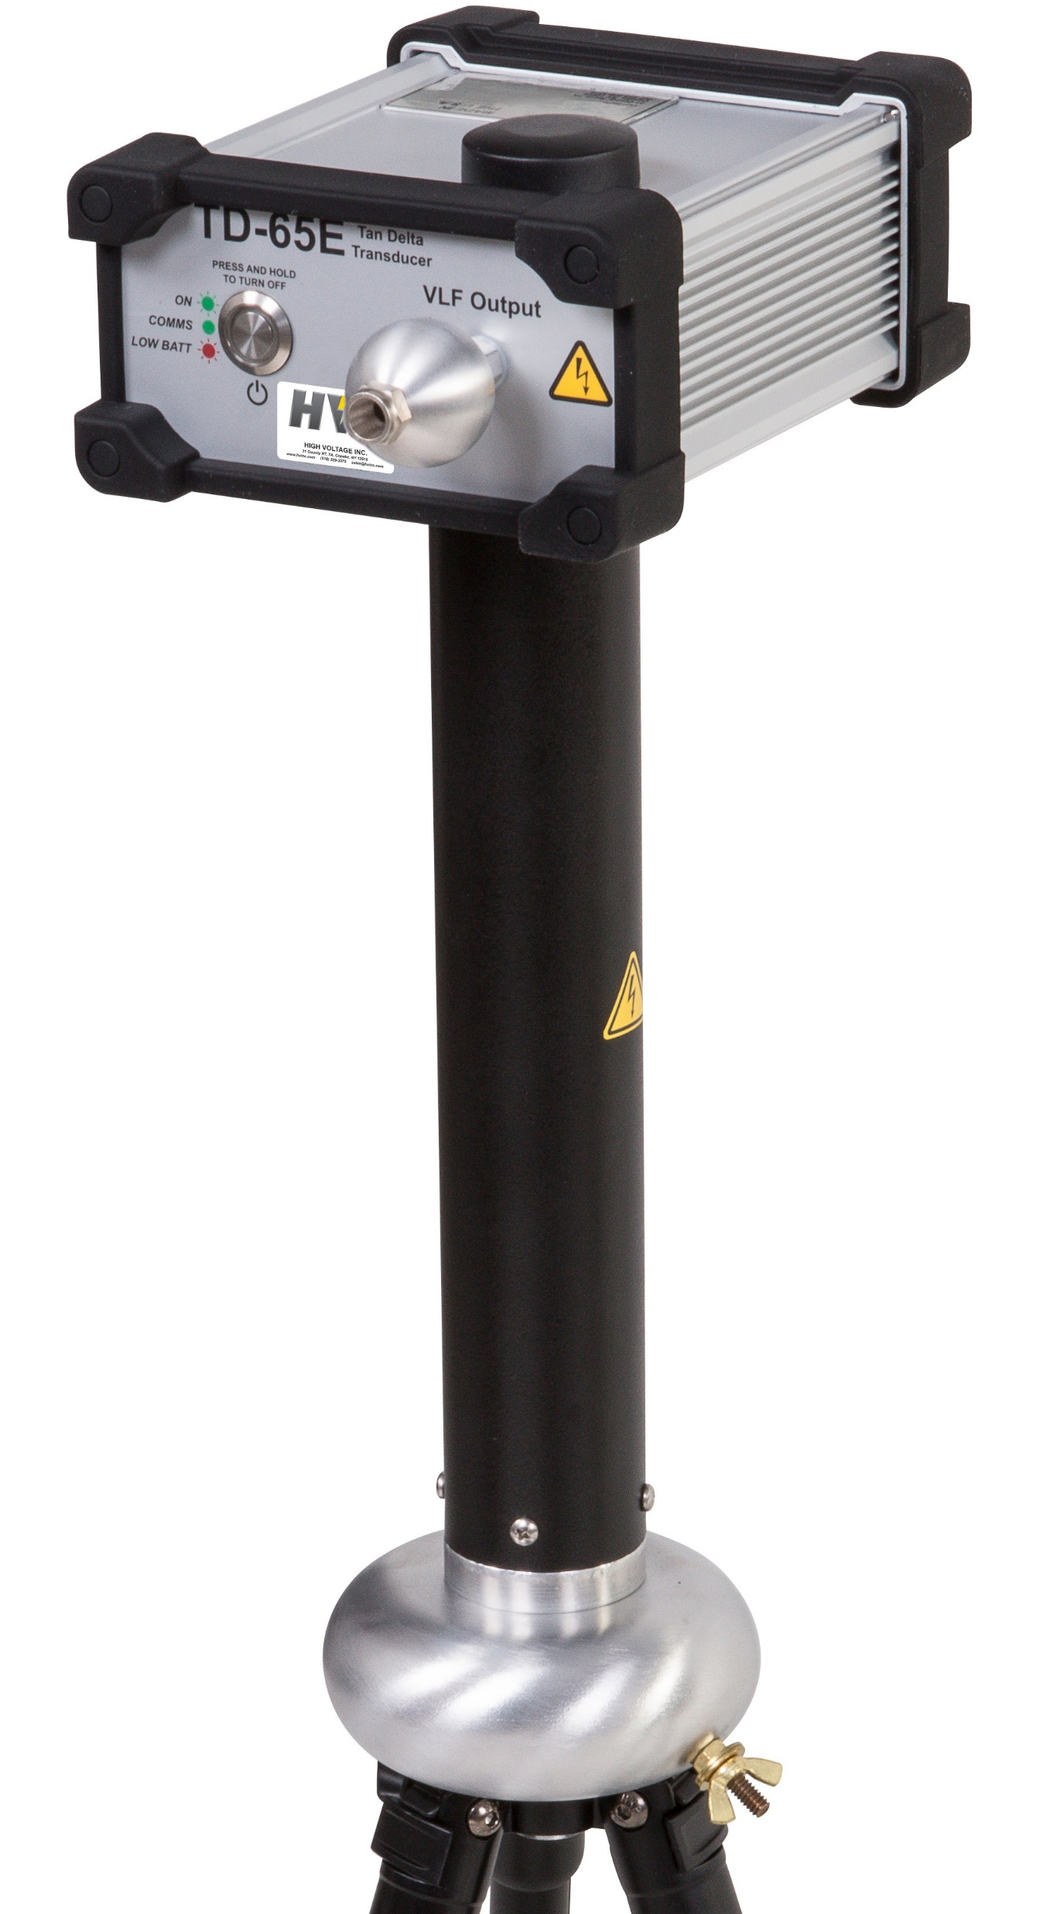
Step 1: Ground VLF and Tan Delta Bridge
Connect the ground stud of the VLF and Tan Delta Bridge to the grounded concentric neutral of the cable under test
Grounded
Neutral
VLF-34E Shown
TD-65E Shown
ISO 9001 2008
The World’s Source for High Voltage Test Equipment
MADE IN THE USA
High Voltage, Inc. • hvinc.com • p. 518.329.3275 • f. 518.329.3271 • 31 County Route 7A • Copake, NY 12516 USA

Slide 5
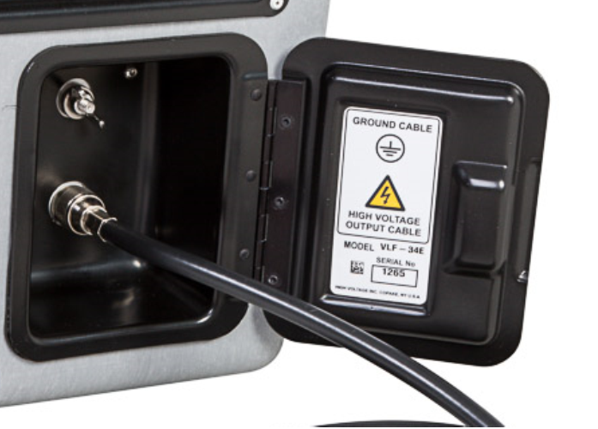
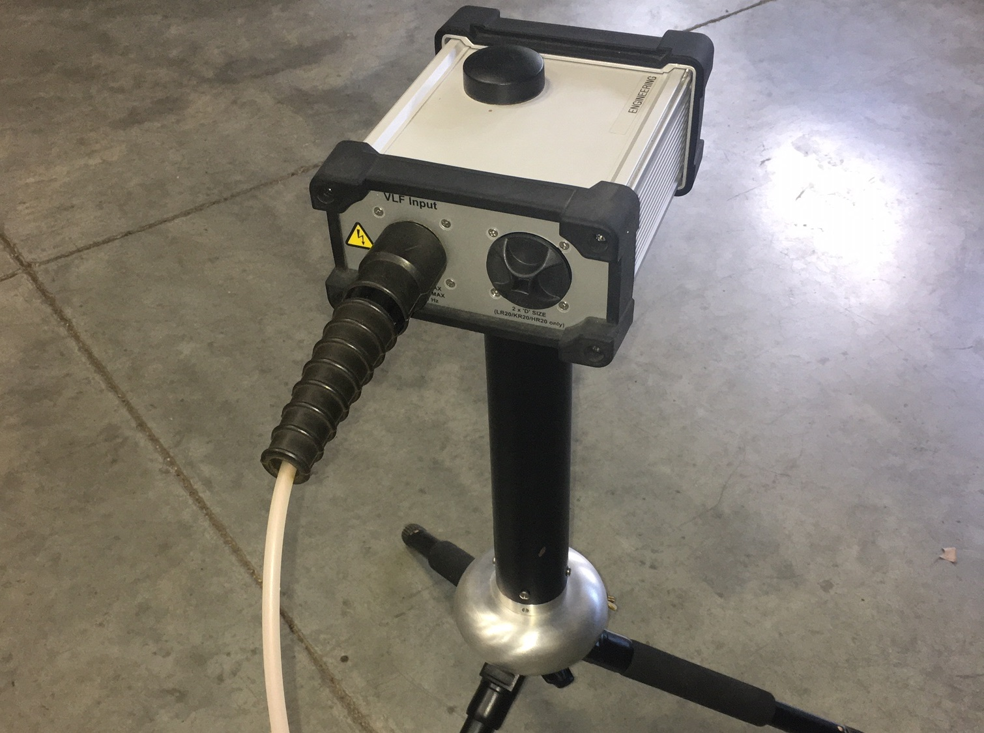
Step 2: Install High Voltage Output Cable from VLF to Tan Delta Bridge
Install shielded output cable
supplied with TD Bridge
MC Connector, Push in to install
Push in, then pull out to remove
Push in MC Connector into socket
and pigtail ground to ground stud
ISO 9001 2008
The World’s Source for High Voltage Test Equipment
MADE IN THE USA
High Voltage, Inc. • hvinc.com • p. 518.329.3275 • f. 518.329.3271 • 31 County Route 7A • Copake, NY 12516 USA

Slide 6
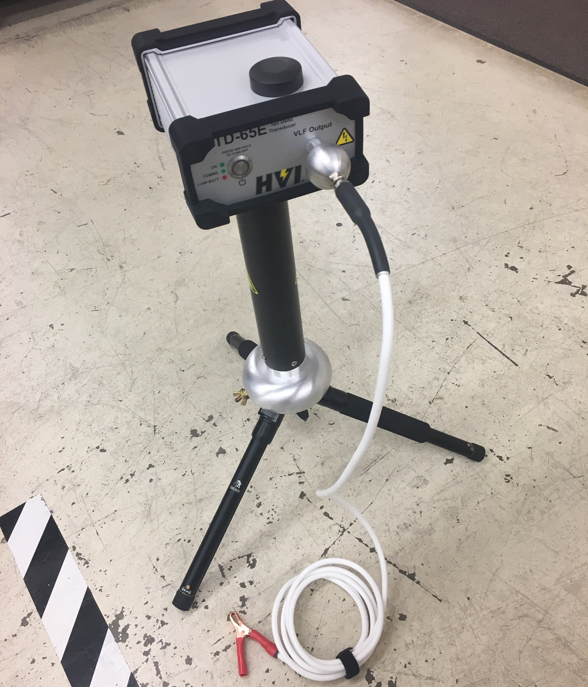
Step 3: Install High Voltage Output Cable from Tan Delta Bridge to cable under test
White insulated, unshielded output
cable plugs into sphere and clip goes to
cable under test. Keep this cable away
from ground 6-8 inches (12cm – 20cm)
or more. Use the supplied corona suppressing
toroid to reduce electrical discharge (PD)
ISO 9001 2008
The World’s Source for High Voltage Test Equipment
MADE IN THE USA
High Voltage, Inc. • hvinc.com • p. 518.329.3275 • f. 518.329.3271 • 31 County Route 7A • Copake, NY 12516 USA

Slide 7
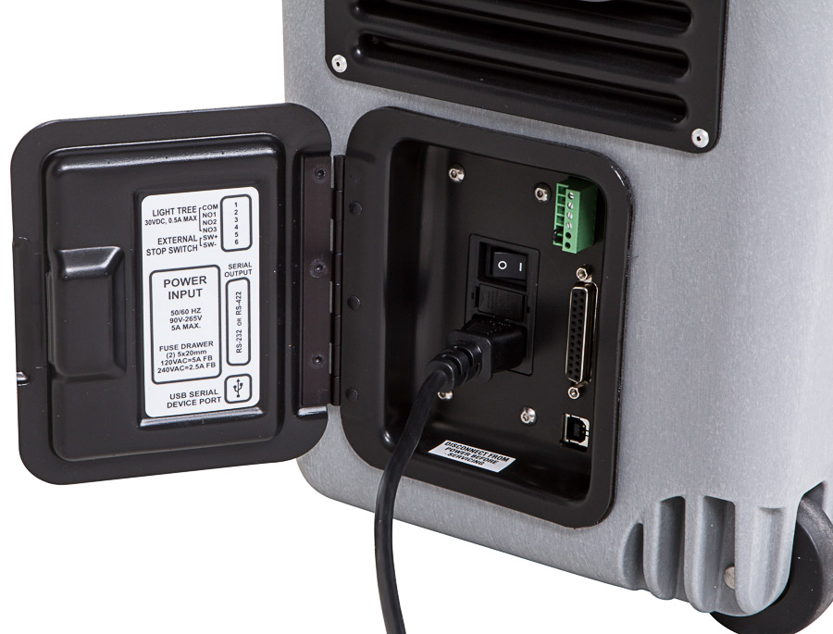
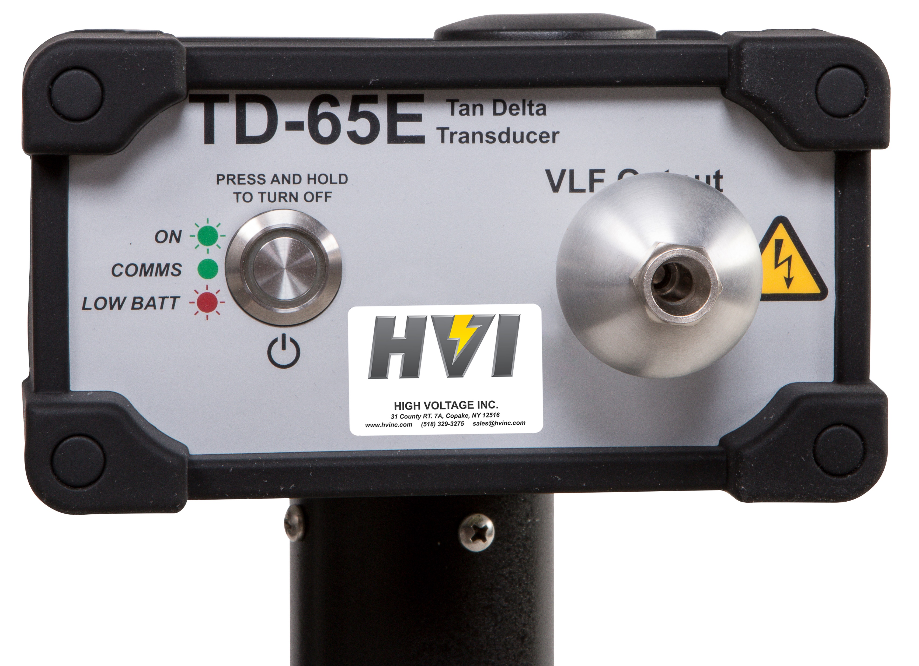
Step 4: Power on VLF and Tan Delta Bridge
Turn on both the VLF
And Tan Delta Bridge
Light should blink
green, if red change
the batteries
ISO 9001 2008
The World’s Source for High Voltage Test Equipment
MADE IN THE USA
High Voltage, Inc. • hvinc.com • p. 518.329.3275 • f. 518.329.3271 • 31 County Route 7A • Copake, NY 12516 USA

Slide 8
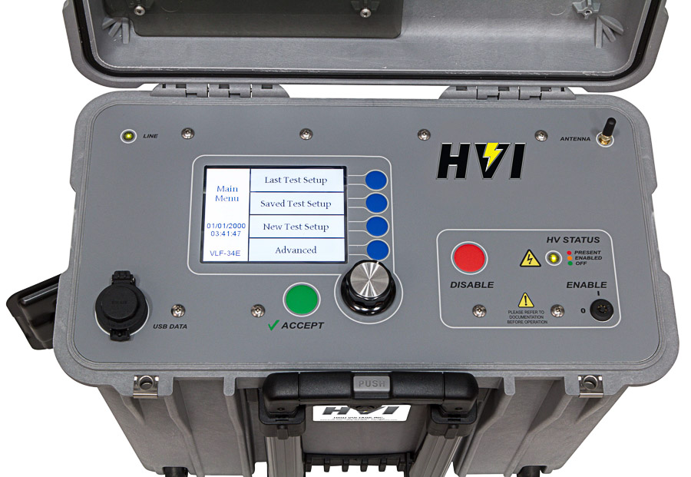
Step 5: Set VLF Measurement Source to TD
Push the blue button to enter Advanced screen
Scroll down to “Measurement Source”
Push down on the encoder or press the green button
Choose TD-34/65, TD-34, or TD-65 (depending on model)
Push down on the encoder or press the green button
Check light on Tan Delta module
ISO 9001 2008
The World’s Source for High Voltage Test Equipment
MADE IN THE USA
High Voltage, Inc. • hvinc.com • p. 518.329.3275 • f. 518.329.3271 • 31 County Route 7A • Copake, NY 12516 USA

Slide 9
Step 6: Verify solid green light on Tan Delta bridge
The light on the Tan Delta Bridge should change
from blinking green to solid green confirming the
Xbee wireless connection between the VLF and Tan
Delta bridge has been established
ISO 9001 2008
The World’s Source for High Voltage Test Equipment
MADE IN THE USA
High Voltage, Inc. • hvinc.com • p. 518.329.3275 • f. 518.329.3271 • 31 County Route 7A • Copake, NY 12516 USA

Slide 10

Step 7: The VLF and Tan Delta are ready to test
Press the blue button for “New Test Setup”
Choose “Sinewave “ for waveform
Choose the desired output frequency (0.1Hz)
Choose voltage step 1
  Set up first test voltage (0.5 x u0)
  Set duration for 3 minutes
Choose voltage step 2
  Set up first test voltage (u0)
  Set duration for 3 minutes
Choose voltage step 3
  Set up first test voltage (1.5 x u0)
  Set duration for 3 minutes
Choose “Fault” as “Overload on Arc”
Press the blue button to start the test
ISO 9001 2008
The World’s Source for High Voltage Test Equipment
MADE IN THE USA
High Voltage, Inc. • hvinc.com • p. 518.329.3275 • f. 518.329.3271 • 31 County Route 7A • Copake, NY 12516 USA

Slide 11
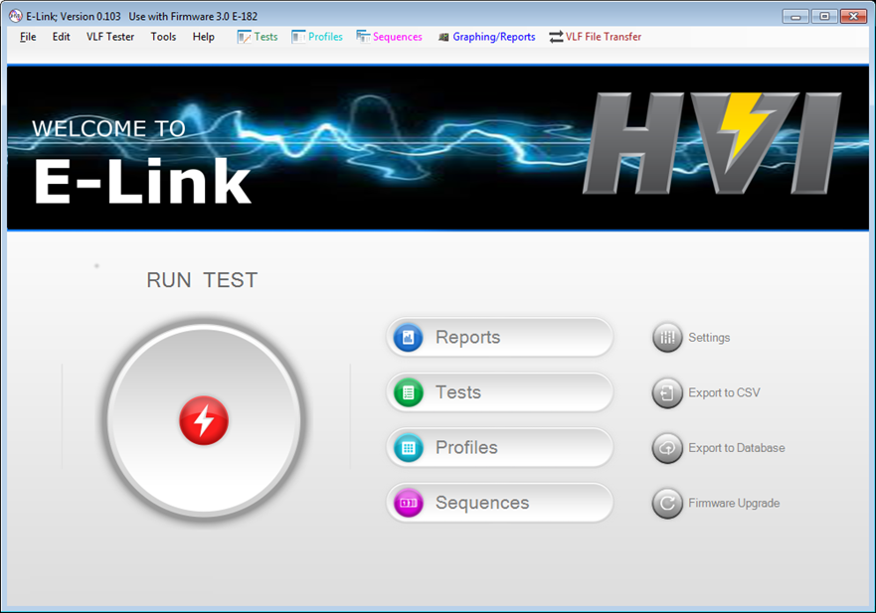
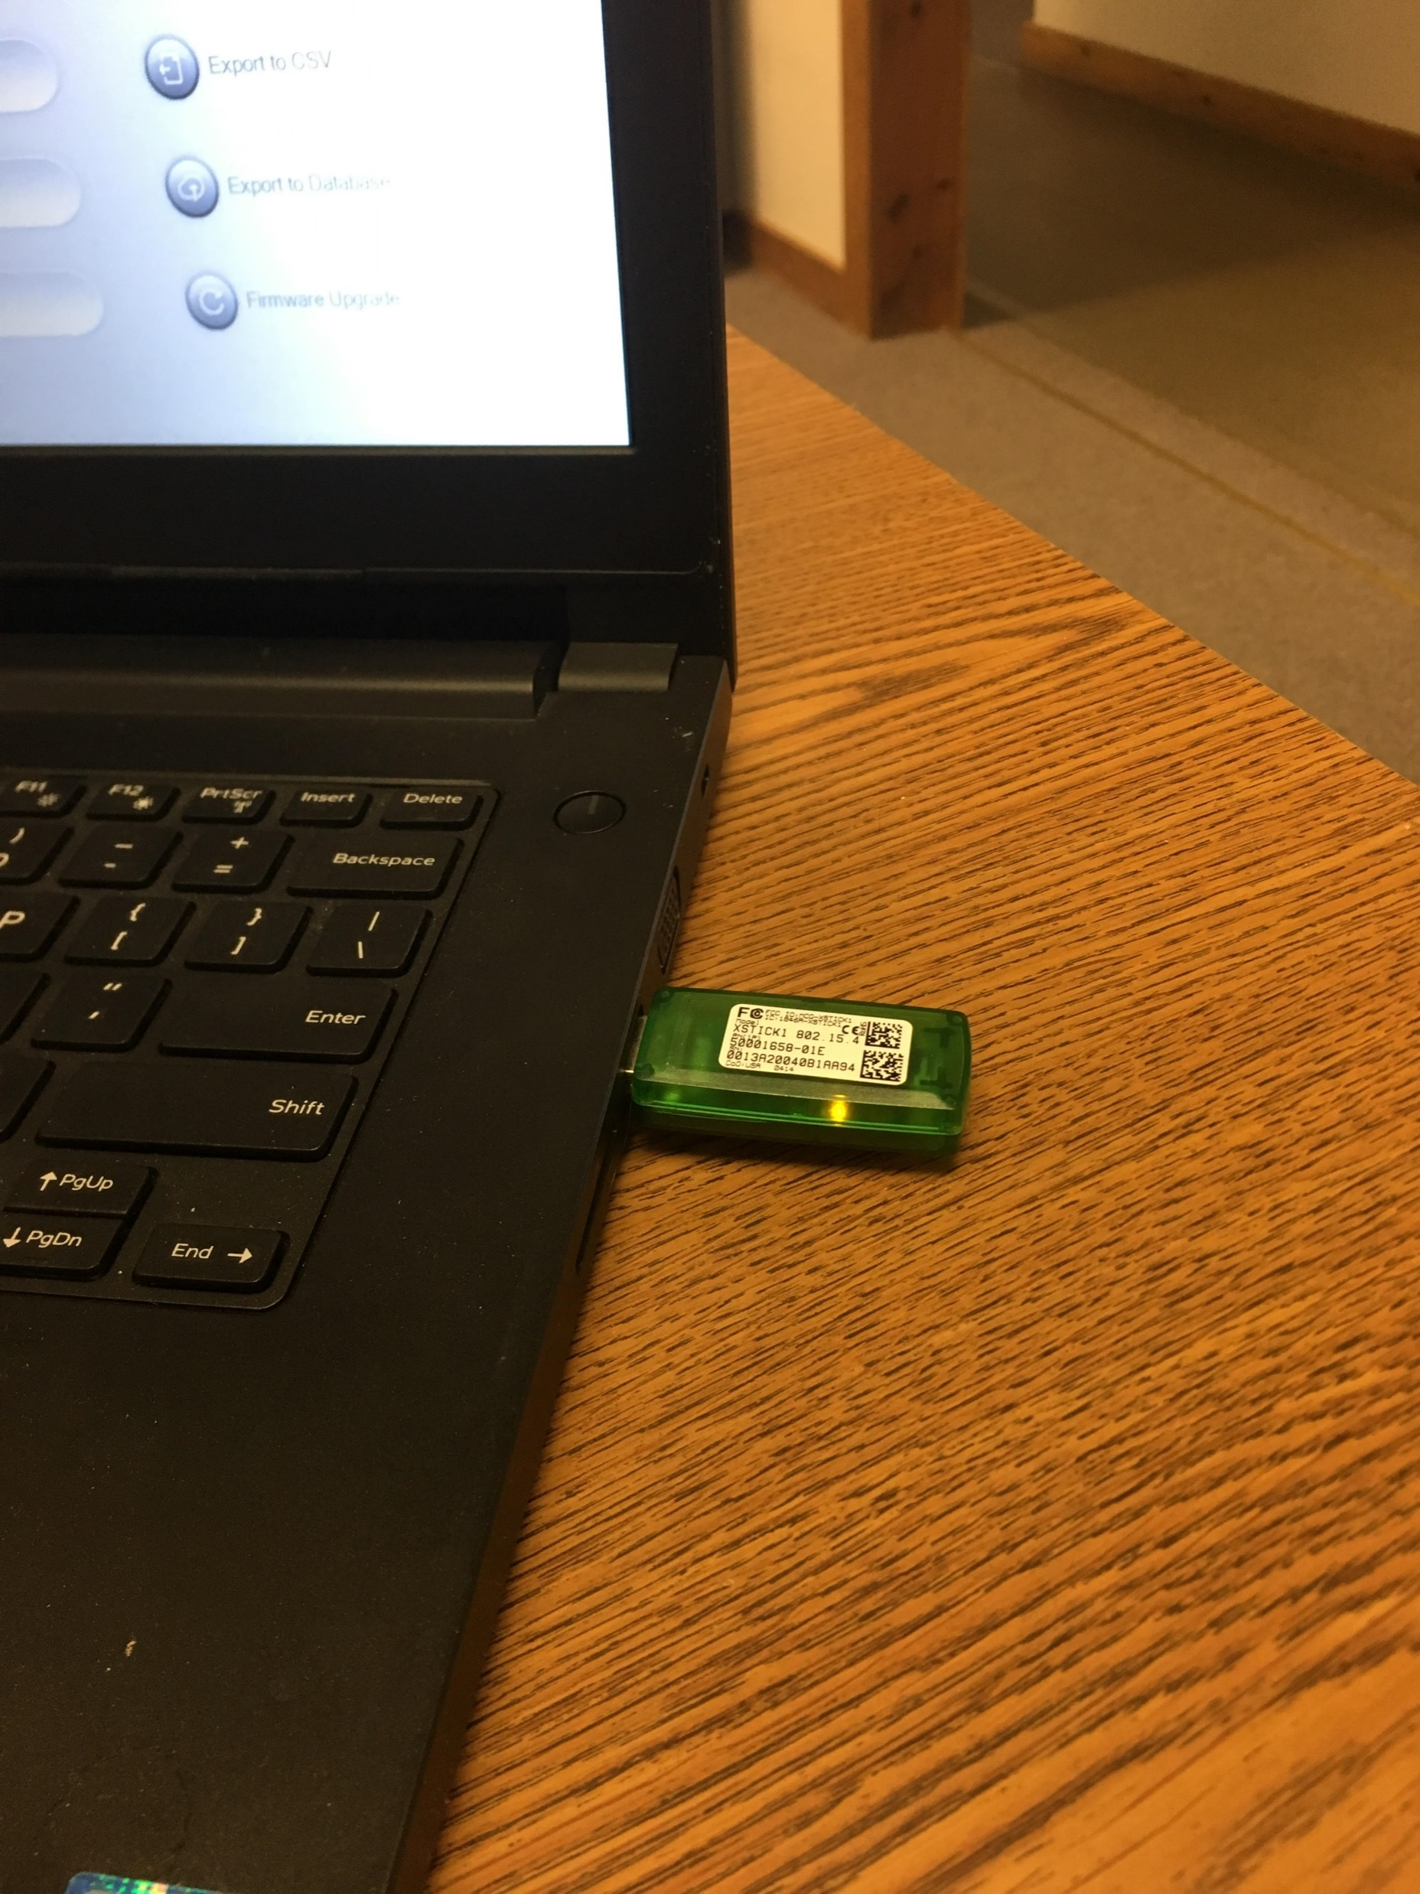
Control of VLF and Tan Delta via E-Link with PC
ISO 9001 2008
The World’s Source for High Voltage Test Equipment
MADE IN THE USA
High Voltage, Inc. • hvinc.com • p. 518.329.3275 • f. 518.329.3271 • 31 County Route 7A • Copake, NY 12516 USA

Slide 12

Step 8: Insert the green USB Xbee Antenna into PC
Plug green USB Xbee Antenna into PC
Install the drivers for the Xbee Antenna
Download via the Internet (or)
Download via the red HVI flash drive
ISO 9001 2008
The World’s Source for High Voltage Test Equipment
MADE IN THE USA
High Voltage, Inc. • hvinc.com • p. 518.329.3275 • f. 518.329.3271 • 31 County Route 7A • Copake, NY 12516 USA

Slide 13
Step 9: Open E-Link Software
Install the E-Link software from the red HVI flash drive
Open the E-Link software
Click on “Settings”
Click on the “Communications” tab
Click the “Auto Detect” button
The software should automatically assign a serial port
Click “Close”
If you have issues please contact factory@hvinc.com
ISO 9001 2008
The World’s Source for High Voltage Test Equipment
MADE IN THE USA
High Voltage, Inc. • hvinc.com • p. 518.329.3275 • f. 518.329.3271 • 31 County Route 7A • Copake, NY 12516 USA

Slide 14
Step 10: Click “RUN TEST”
ISO 9001 2008
The World’s Source for High Voltage Test Equipment
MADE IN THE USA
High Voltage, Inc. • hvinc.com • p. 518.329.3275 • f. 518.329.3271 • 31 County Route 7A • Copake, NY 12516 USA

Slide 15
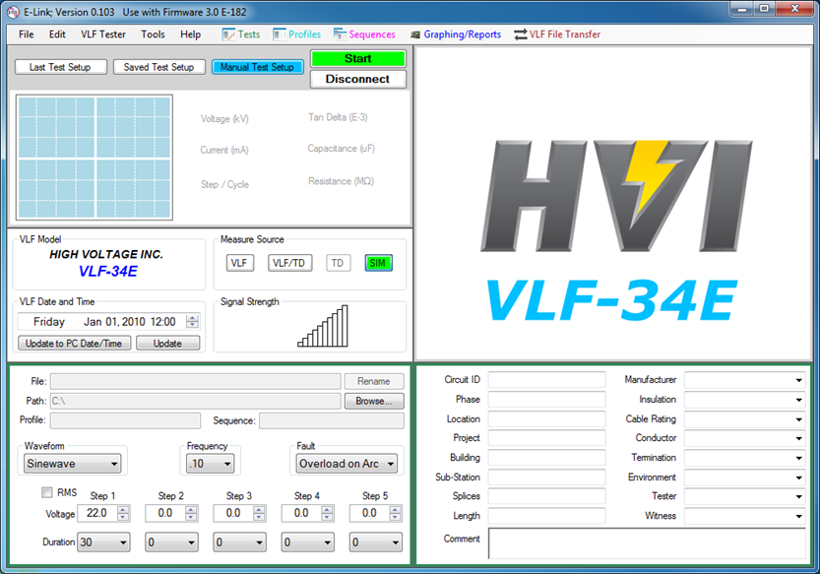
Step 11: Ready to program the test using E-Link
Choose “VLF/TD” as your “Measurement Source”
Choose “Sinewave” as your “Waveform”
Choose your output frequency (.1Hz is normal for TD)
Choose voltage step 1
  Set up first test voltage (0.5 x u0)
  Set duration for 3 minutes
Choose voltage step 2
  Set up first test voltage (u0)
  Set duration for 3 minutes
Choose voltage step 3
  Set up first test voltage (1.5 x u0)
  Set duration for 3 minutes
Choose “Fault” as “Overload on Arc”
Click the green “Start” Button
ISO 9001 2008
The World’s Source for High Voltage Test Equipment
MADE IN THE USA
High Voltage, Inc. • hvinc.com • p. 518.329.3275 • f. 518.329.3271 • 31 County Route 7A • Copake, NY 12516 USA

Slide 16

Thank You
from
Thank you for watching, if you have any questions please contact
High Voltage, Inc. or your local High Voltage, Inc. sales representative
ISO 9001 2008
The World’s Source for High Voltage Test Equipment
MADE IN THE USA
High Voltage, Inc. • hvinc.com • p. 518.329.3275 • f. 518.329.3271 • 31 County Route 7A • Copake, NY 12516 USA

