Slide 1
ISO 9001 2015
The World’s Source for High Voltage Test Equipment
MADE IN THE USA
High Voltage, Inc. • hvinc.com • p. 518.329.3275 • f. 518.329.3271 • 31 County Route 7A • Copake, NY 12516 USA

Slide 2
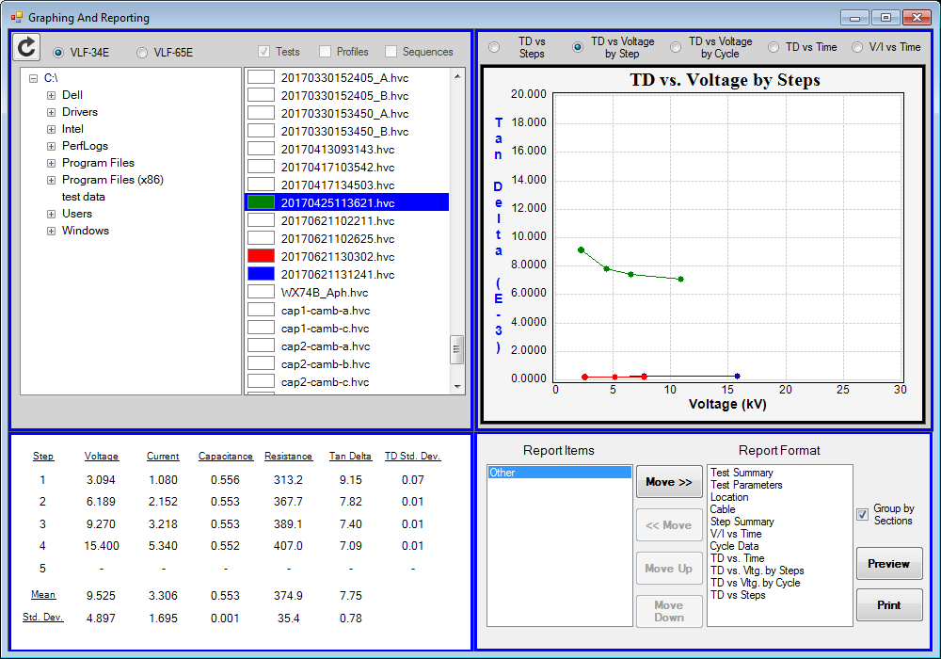
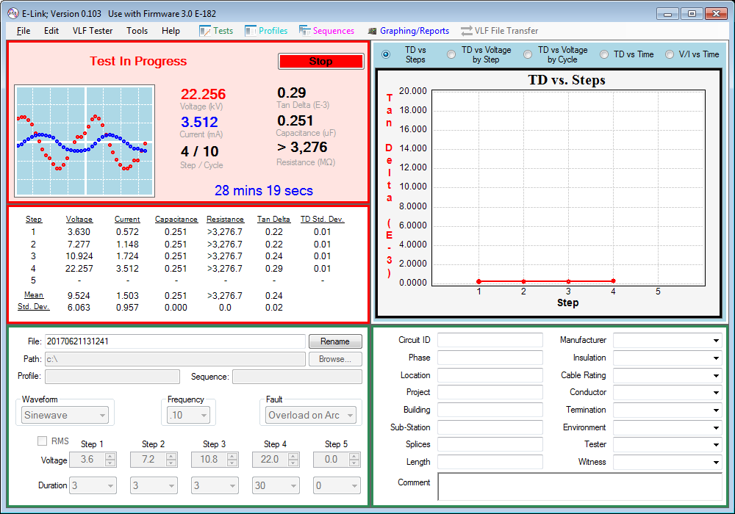
E-Link is HVI’s feature packed remote control and report generation software package
ISO 9001 2015
The World’s Source for High Voltage Test Equipment
MADE IN THE USA
High Voltage, Inc. • hvinc.com • p. 518.329.3275 • f. 518.329.3271 • 31 County Route 7A • Copake, NY 12516 USA

Slide 3
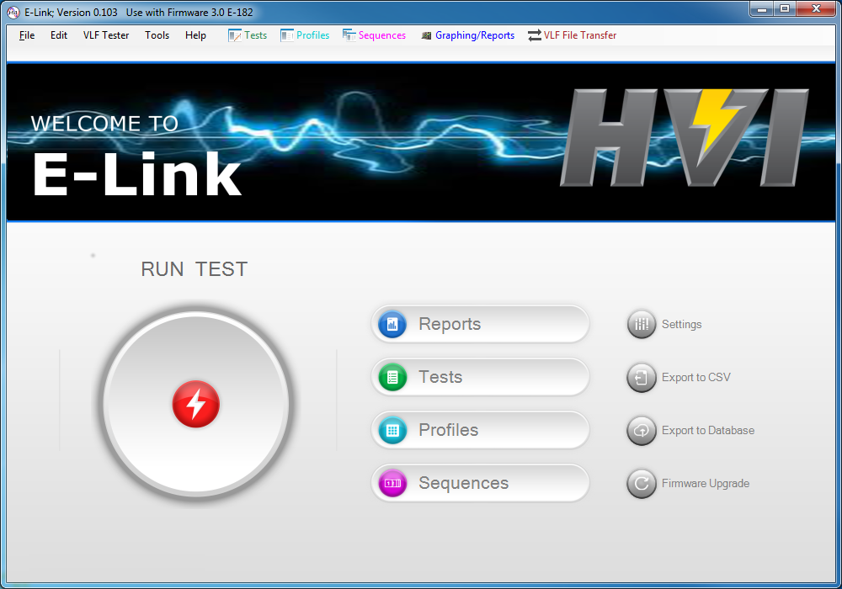
The Home Screen
View or edit previous tests
Edit and change settings
Click to view or create a test report
Export test data to .csv format
Click to run a test
Export test data to an external database
Combine multiple test profiles into sequences
Create or edit test profiles
Upgrade your hipot to latest firmware version
ISO 9001 2015
The World’s Source for High Voltage Test Equipment
MADE IN THE USA
High Voltage, Inc. • hvinc.com • p. 518.329.3275 • f. 518.329.3271 • 31 County Route 7A • Copake, NY 12516 USA

Slide 4
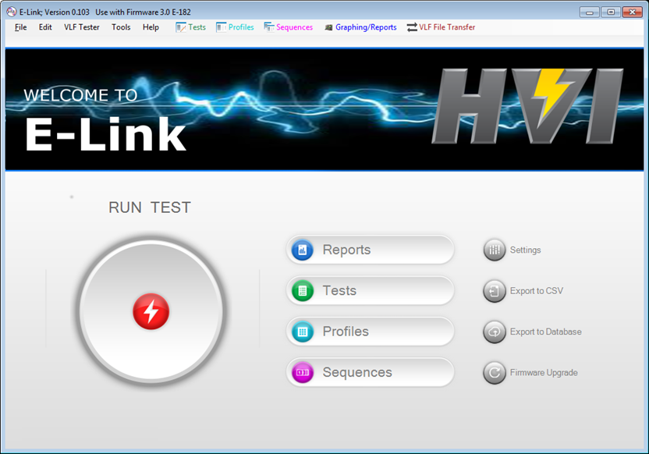
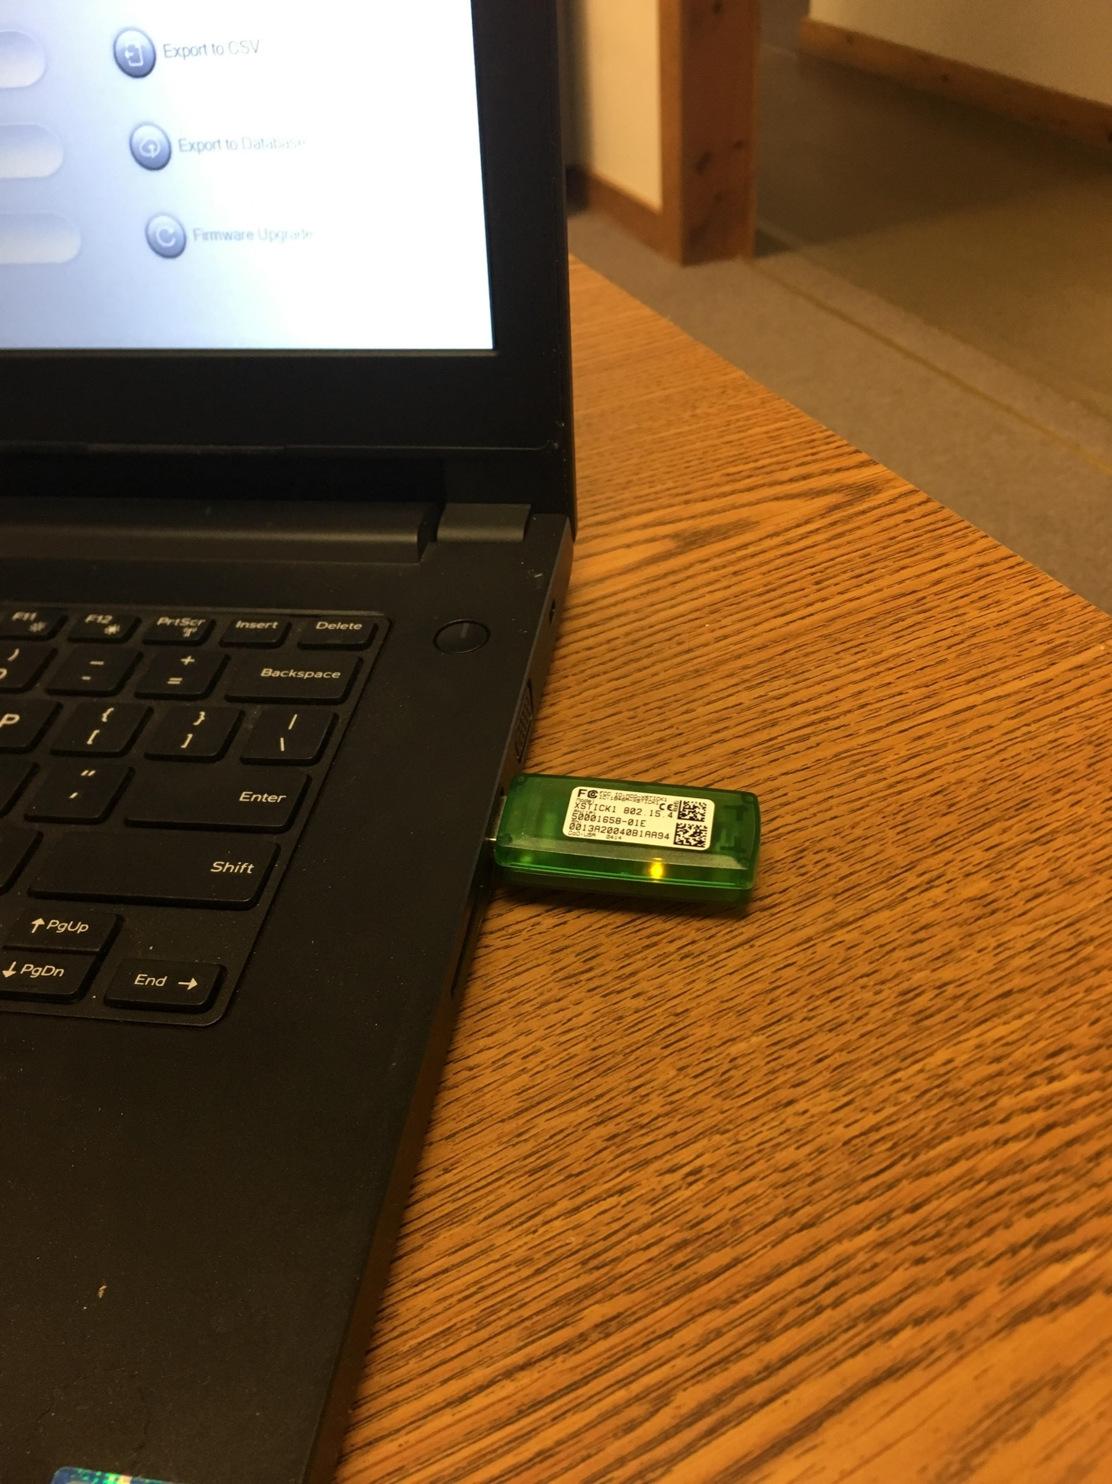
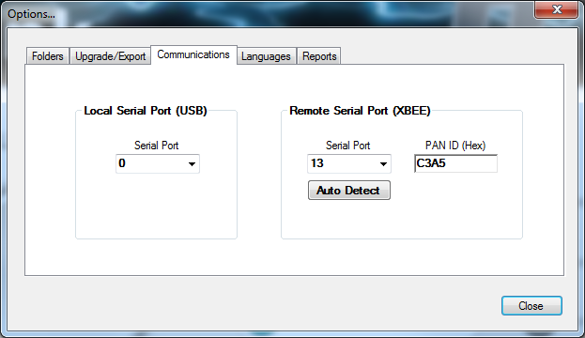
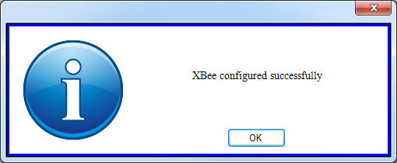
Connecting Wirelessly to VLF
Click on settings
Plug in the X-Stick into a USB Port
Click on Auto Detect
ISO 9001 2015
The World’s Source for High Voltage Test Equipment
MADE IN THE USA
High Voltage, Inc. • hvinc.com • p. 518.329.3275 • f. 518.329.3271 • 31 County Route 7A • Copake, NY 12516 USA

Slide 5
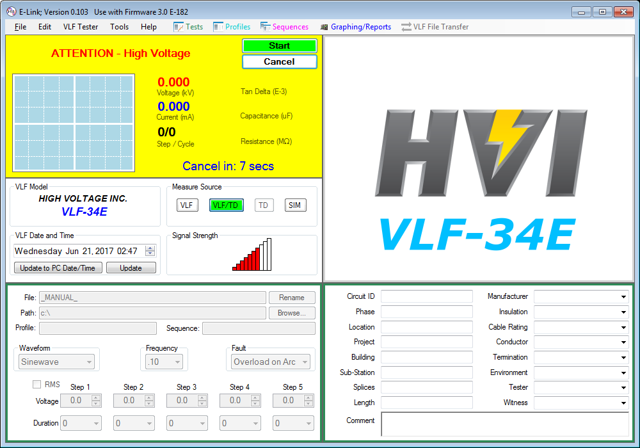
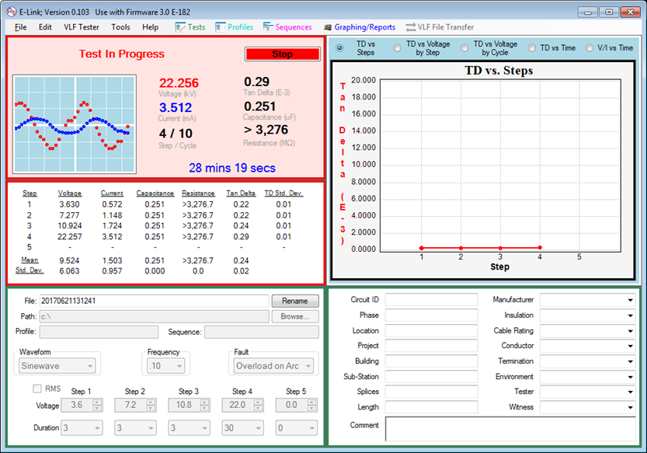
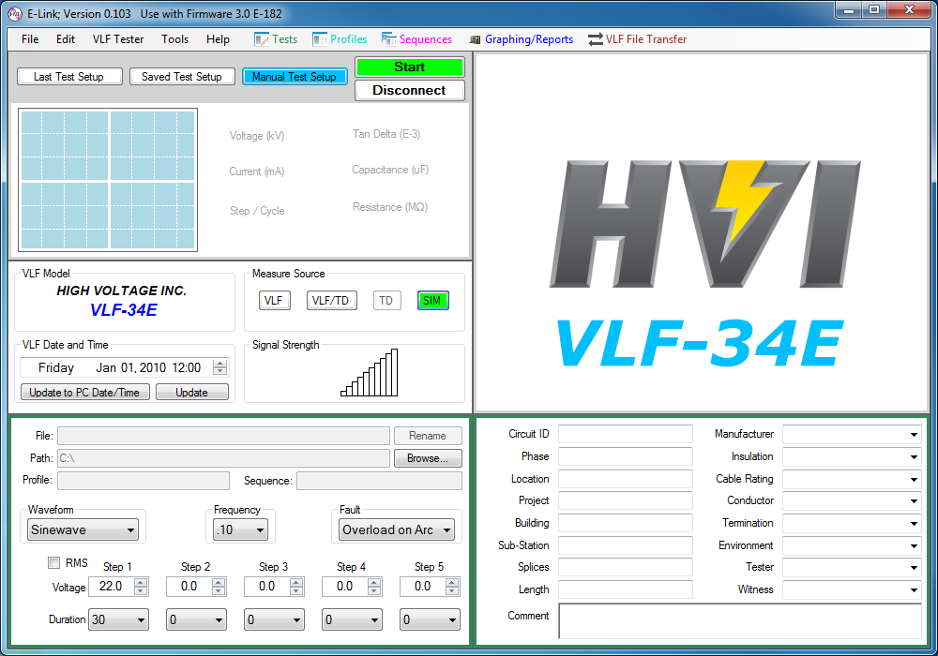
Remote Operation of Hipot via XBee Wireless Protocol
Click start to begin test
Click Start for a second time to confirm action
Click Run Test
Graph for analysis of TD, V, I, and Time
Choose a measurement source
Choose waveform:
+ DC, - DC, sinewave or squarewave
Choose a voltage and dwell time to spend at each voltage
Live test data
Test data from each step
Click this box to toggle between RMS and Peak metering, metering in RMS if checked
Add identifying information about the system under test
ISO 9001 2015
The World’s Source for High Voltage Test Equipment
MADE IN THE USA
High Voltage, Inc. • hvinc.com • p. 518.329.3275 • f. 518.329.3271 • 31 County Route 7A • Copake, NY 12516 USA

Slide 6
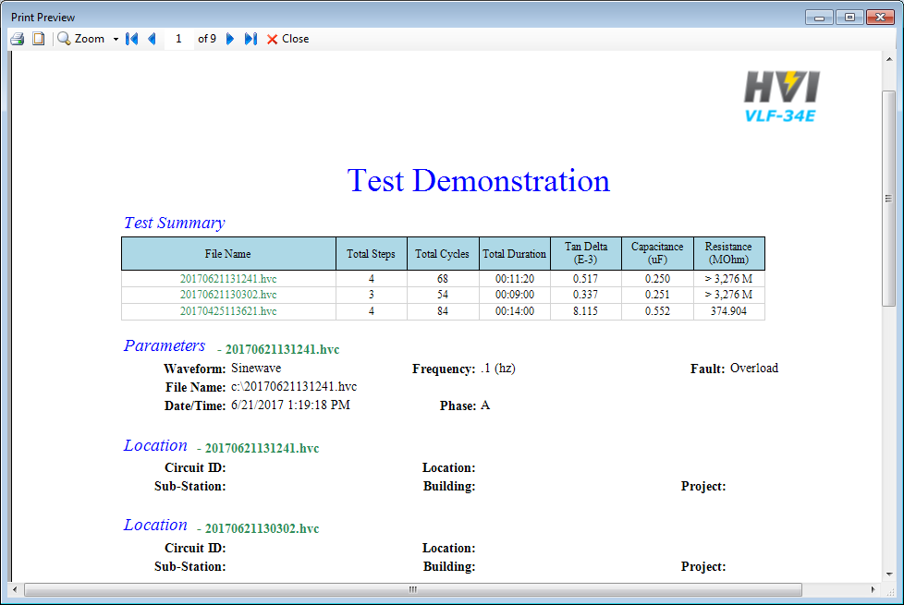
Custom Report Generation
Choose the location where the test data is stored
Choose files for the report
Your test report has been created
Click on Reports
Choose preview or print to review/generate the report
Choose what data for the report
ISO 9001 2015
The World’s Source for High Voltage Test Equipment
MADE IN THE USA
High Voltage, Inc. • hvinc.com • p. 518.329.3275 • f. 518.329.3271 • 31 County Route 7A • Copake, NY 12516 USA

Slide 7
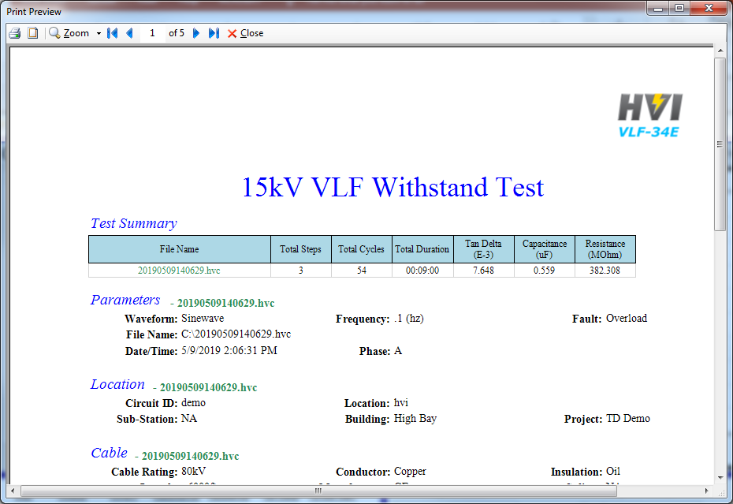
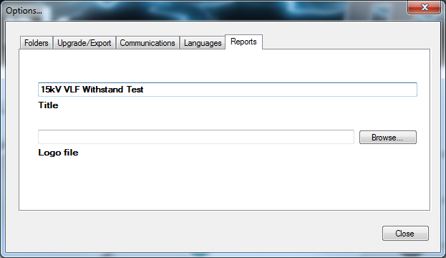
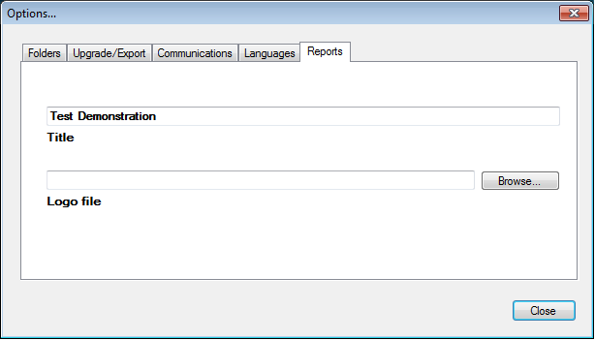
Change the Test Report Title
The test report has an updated title
Click on setting
Type in what you want the title to be
ISO 9001 2015
The World’s Source for High Voltage Test Equipment
MADE IN THE USA
High Voltage, Inc. • hvinc.com • p. 518.329.3275 • f. 518.329.3271 • 31 County Route 7A • Copake, NY 12516 USA

Slide 8
Add Your Company’s Logo to Report
Your company logo will appear here
Browse and choose the your company logo file in .jpg, .png. Or .bmp format
Click on setting
ISO 9001 2015
The World’s Source for High Voltage Test Equipment
MADE IN THE USA
High Voltage, Inc. • hvinc.com • p. 518.329.3275 • f. 518.329.3271 • 31 County Route 7A • Copake, NY 12516 USA

Slide 9
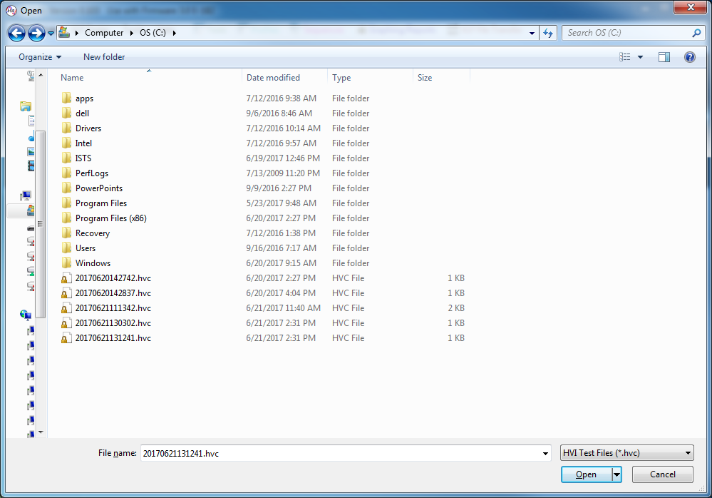
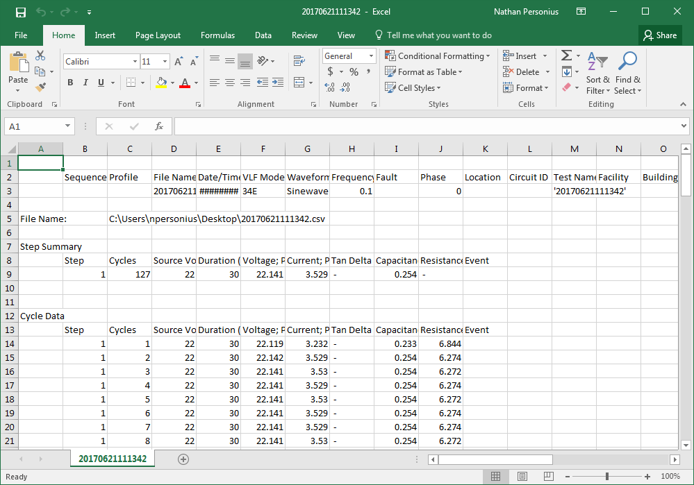
Export to .csv for Advanced Report Generation
Click on export to .csv
Your test report data has been imported to .csv format, open with Excel or other spreadsheet program
Choose one of the saved test data files which are .hvc files
Click on open
ISO 9001 2015
The World’s Source for High Voltage Test Equipment
MADE IN THE USA
High Voltage, Inc. • hvinc.com • p. 518.329.3275 • f. 518.329.3271 • 31 County Route 7A • Copake, NY 12516 USA

Slide 10
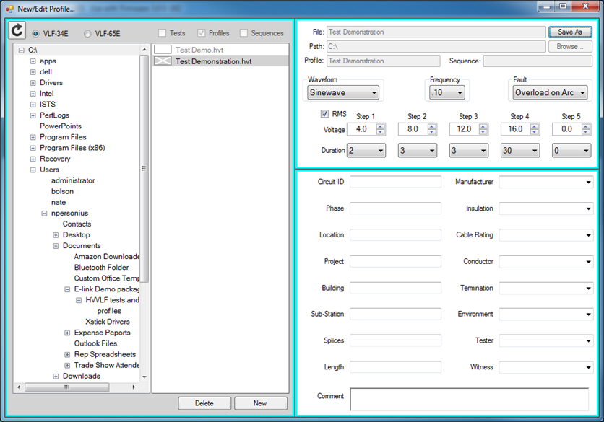
Build Custom Test Profiles
Choose your waveform, frequency, overload reaction, add test voltage and dwell time for each voltage for up to 5 steps
Click on profiles
Add test location and system identification information here
Create a profile name and press ok
Click on new to create test profile
ISO 9001 2015
The World’s Source for High Voltage Test Equipment
MADE IN THE USA
High Voltage, Inc. • hvinc.com • p. 518.329.3275 • f. 518.329.3271 • 31 County Route 7A • Copake, NY 12516 USA

Slide 11
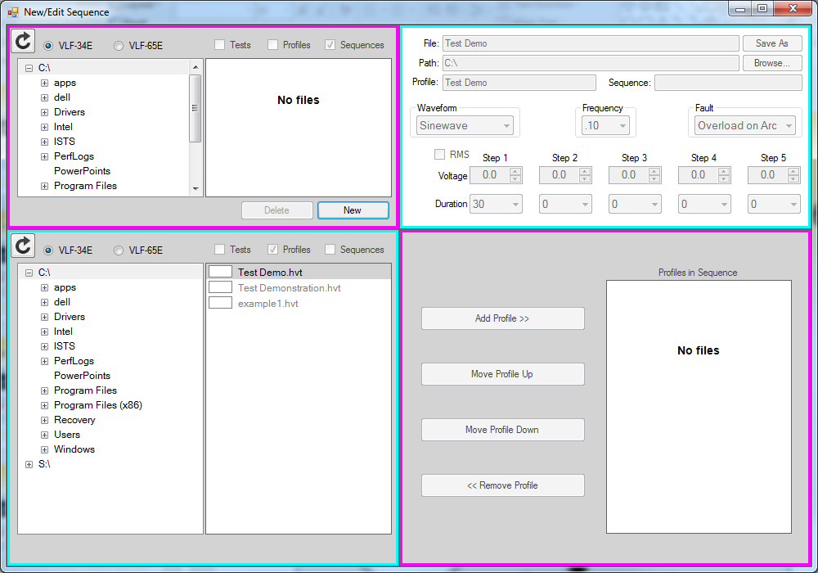
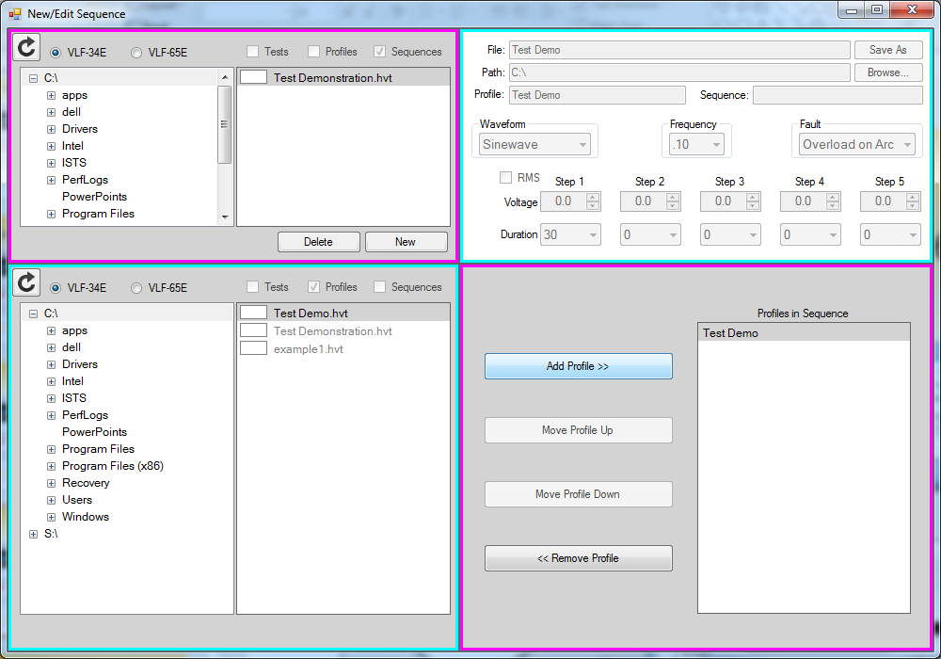
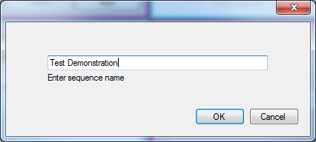
Build Custom Test Sequences
Choose the desired test profiles in the left column to the right column using the add profile button or remove profile button. Choose hierarchy of test profiles with move profile up button and move profile down button.
Click on sequences
Click on new to create a test sequence
Enter a name for he test sequence
ISO 9001 2015
The World’s Source for High Voltage Test Equipment
MADE IN THE USA
High Voltage, Inc. • hvinc.com • p. 518.329.3275 • f. 518.329.3271 • 31 County Route 7A • Copake, NY 12516 USA

Slide 12
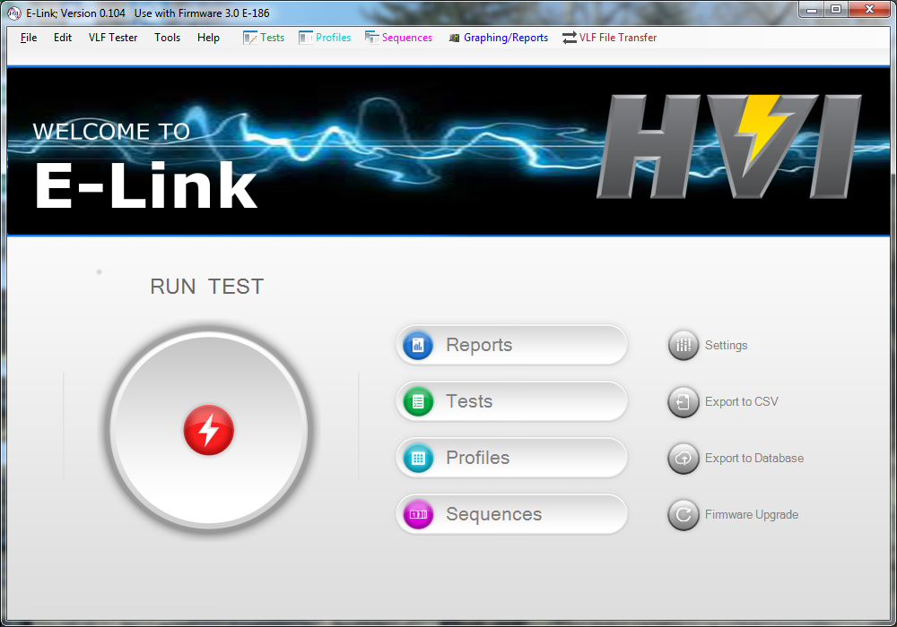
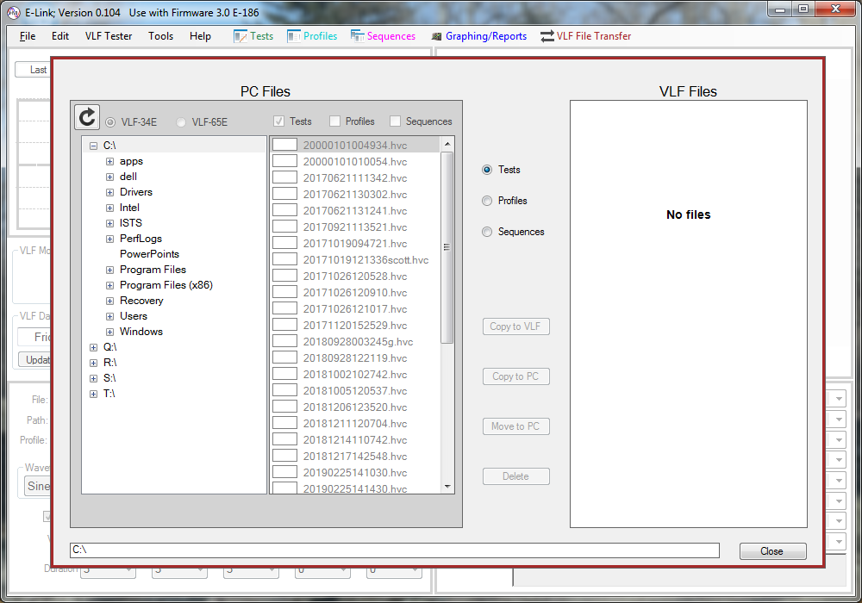
Wireless File Transfer Between PC and VLF
Click on VLF File Transfer
Click here to choose files created by the VLF-34E or VLF-65E
Click here to choose between saved tests, profiles, and sequences
Click here to copy files from PC to VLF
Click here to copy files from VLF to PC
Click here to move files from VLF to PC and delete from VLF
Click here to delete files on the VLF
ISO 9001 2015
The World’s Source for High Voltage Test Equipment
MADE IN THE USA
High Voltage, Inc. • hvinc.com • p. 518.329.3275 • f. 518.329.3271 • 31 County Route 7A • Copake, NY 12516 USA

Slide 13
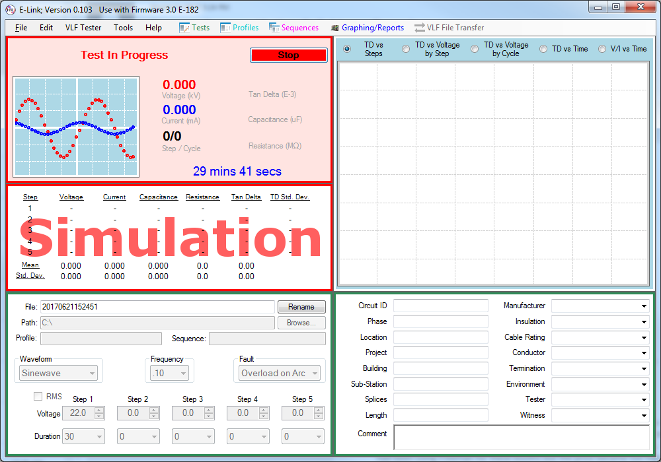
Simulation Mode
Click start twice to confirm action
Choose sim as measurement source
Click run test
Graph for analysis of simulated TD, V, I, and time data
Choose waveform:
+ DC, - DC, sinewave or squarewave
Simulated test data
Simulated test data from each step
Click this box to toggle between RMS and Peak metering, metering in RMS if checked
ISO 9001 2015
The World’s Source for High Voltage Test Equipment
MADE IN THE USA
High Voltage, Inc. • hvinc.com • p. 518.329.3275 • f. 518.329.3271 • 31 County Route 7A • Copake, NY 12516 USA

Slide 14
Thank You
from
Thank you for watching, if you have any questions please contact
High Voltage, Inc. or your local High Voltage, Inc. sales representative
ISO 9001 2015
The World’s Source for High Voltage Test Equipment
MADE IN THE USA
High Voltage, Inc. • hvinc.com • p. 518.329.3275 • f. 518.329.3271 • 31 County Route 7A • Copake, NY 12516 USA

